Slide 2
Configuring and Deploying an Engaging Service Portal
LAB0261
Sushruth Chandrashekar
Dylan Lindgren
Senior UI Developer, Platform Innovation
Senior UI Developer, Platform Innovation

Slide 3
Agenda
Introductions
Portals & Pages
Widgets
External Dependencies & Best Practices
Bonus Lab!

Slide 4
Speaker introduction
Name: Sushruth Chandrashekar
Title: Senior UI Developer
Function: Platform Innovation Practice
Company: ServiceNow (San Diego, USA)
Experience/Expertise: Over 8 years of Software Development Experience. Been with ServiceNow for 5 years now. Worked on share.servicenow.com and developer.servicenow.com before moving to Solution Consulting side of the organization.
Current Projects: Working on building cool solutions on ServiceNow platform.

Slide 5
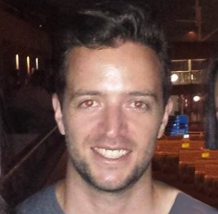
Speaker introduction
Name: Dylan Lindgren
Title: Senior UI Developer
Function: Platform Innovation Practice
Company: ServiceNow (Sydney, Australia)
Experience/Expertise: 20 years of building web pages and apps as a full-stack web developer
Current Projects: Working on building innovative solutions for clients on the ServiceNow platform, with a focus on UX and pushing boundaries.

Slide 6
What you will learn
1
2
3
Configuration of a Service Portal using Service Portal Designer
Structure and composition of a Service Portal
Basics of widget creation & a taste of advanced widget features

Slide 7
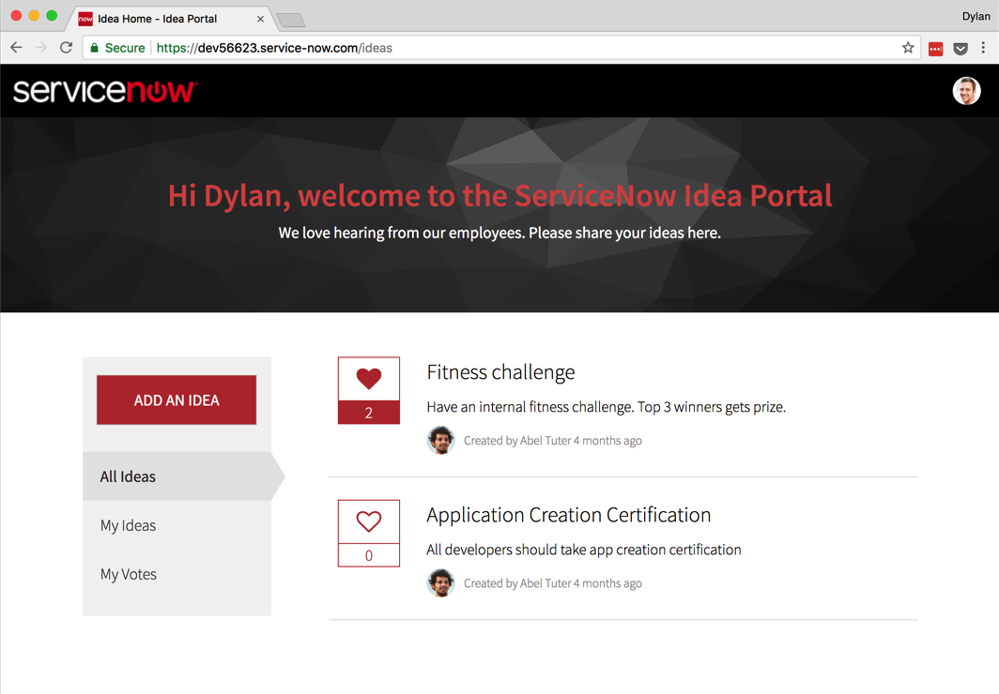
What are we building?
Ideation portal
Submit new ideas
Vote on other ideas
Filter ideas
All ideas
Ideas I’ve submitted
Ideas I’ve voted on
Notes:
So let’s go over what we’re building…

Slide 8
Exercise 1
The Portal Record

Slide 9
Exercise 2
Cloning and Creating Pages

Slide 10
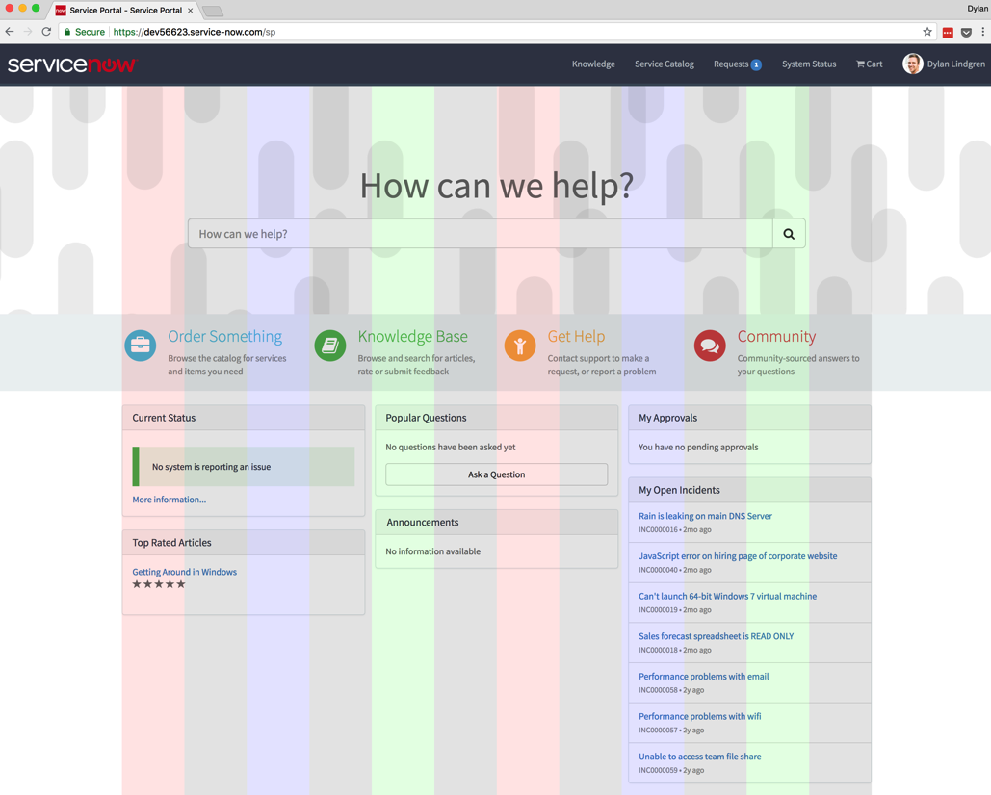
Bootstrap
CSS framework
12 columns
Notes:
Bootstrap is a core part of Service Portal.
Bootstrap is a CSS framework that was developed by Twitter.
Bootstrap partitions your page into a grid of 12 columns.
you can arrange your items on this grid
See in the screenshot of the OOB Service Portal that the items all align to the grid of columns?

Slide 11
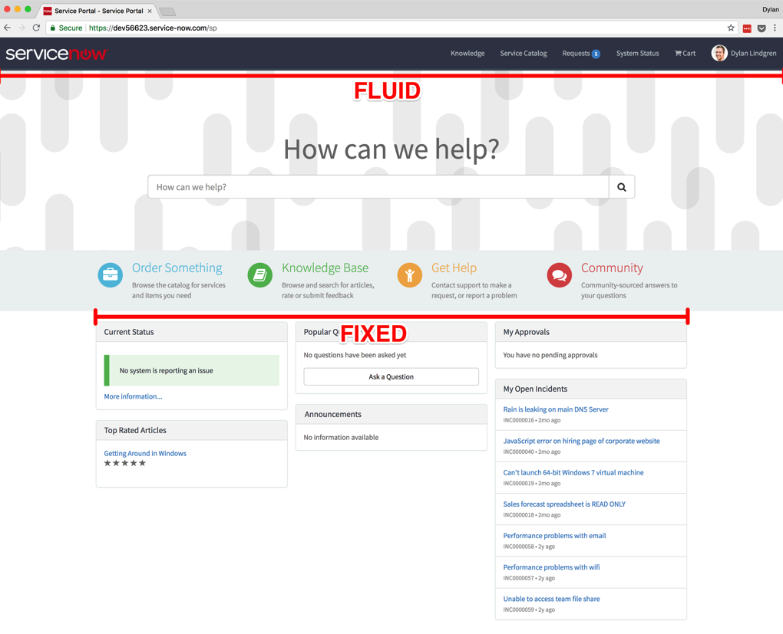
Service portal + bootstrap
In Service Portal, bootstrap columns are embedded inside containers
Containers can be…
Fixed
Default
Fixed container width for each screen size
Extra small
Small
Medium
Large
Fluid
Takes up full width of screen for all screen sizes

Slide 12
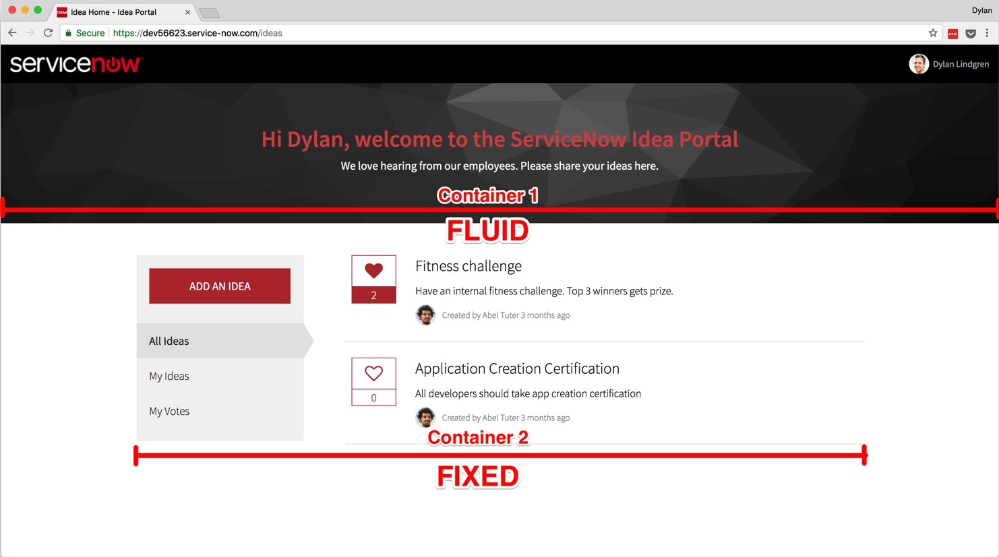
Idea home container layout
Notes:
You can see that on our Idea Home page…
We have two containers
The top container is fluid, hence why it takes up the full width of the page
The bottom container is fixed, hence that on a large screen the most the container will expand to is 1170px.
Fixed containers will always be horizontally centered.

Slide 13
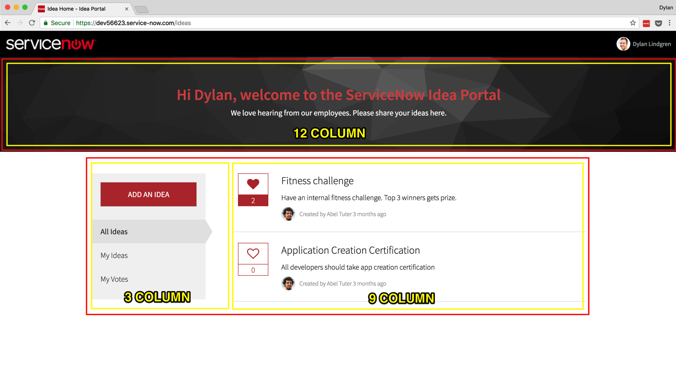
Idea home columns
Notes:
Within each container we can have columns.
You can have as many columns in a container as you like, however the max width of a column is 12 units.
You can see in our top container, we have a single column which is set to 12 units.
In our bottom container, we have 2 columns, the first taking 3 units, the second taking 9 units.

Slide 14
Exercise 3
Banner Widget

Slide 15
Exercise 4
Sidebar Widget

Slide 16
AngularJS event system
You can use it to communicate between widgets
Declare an event as having happened
Throughout other places in your application, you can listen for that event
Data can be passed with the event

Slide 17
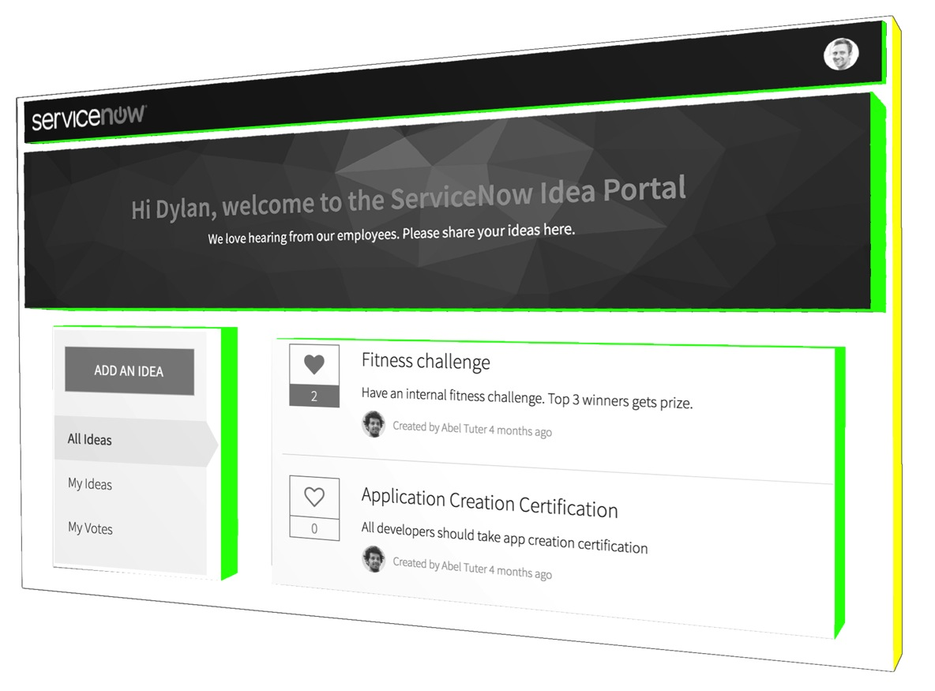
AngularJS scopes
Important to understand for widget communication
Root-scope
Child-scopes
Notes:
If you embed a widget, a child scope will have a child scope of itself.
If you don’t use embedded widgets, all widgets will be siblings of each other in the “scope tree”

Slide 18
$broadcast(), $emit(), and $on()
$broadcast() passes the message downwards through the scope tree
$emit() passes the message upwards through the scope tree
$on() listens for messages that are received by the local scope
All functions exist in on both the local-scope ($scope) and root-scope ($rootScope) objects
Notes:
Scope 3 is an embedded widget, which is embedded in Scope 1.
Scope 1 and Scope 2 are widgets placed on the page using Service Portal Designer – these are siblings of each other.

Slide 19
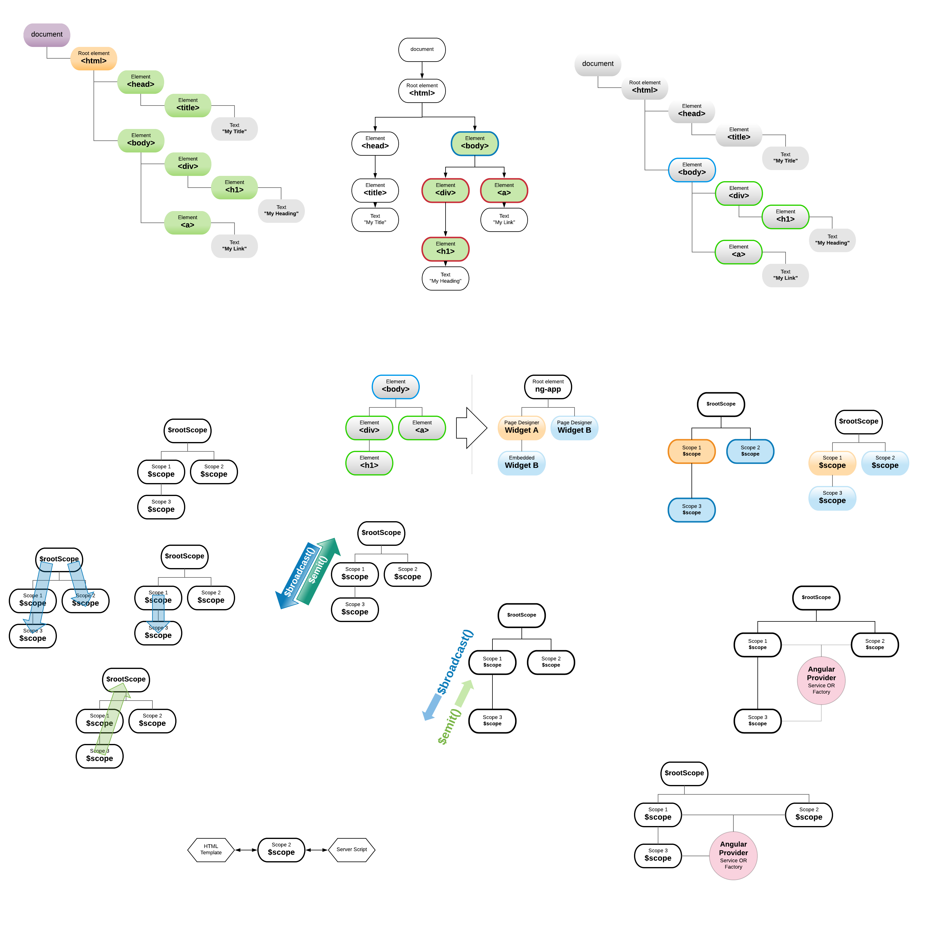
Examples
$scope vs $rootScope
An event $broadcast() on $rootScope will be heard by all child scopes of the root scope (i.e., every scope)
An event $broadcast() on $scope will be heard by child scopes of that scope
Any event $emit() on $scope will be heard by parent scopes of that scope (i.e., the root-scope too)

Slide 20
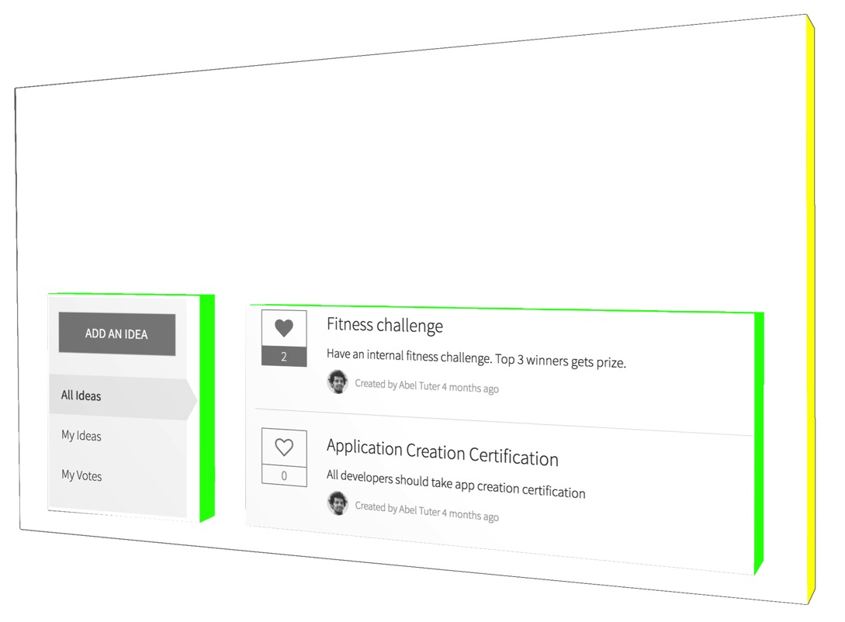
How will we use it?
We will use $rootScope.$broadcast() in the Idea Sidebar widget to reach up to the root scope and broadcast the event
The event will be heard by all scopes on the page
In the Idea List widget we will listen for that event using $scope.$on()
$rootScope.$broadcast()
$scope.$on()

Slide 21
Exercise 5
List Widget

Slide 22
Exercise 6
Submit an Idea Page

Slide 23
Bonus Exercise!
Data Tables

Slide 24
Top takeaways
1
2
3
Configuration of a Service Portal using Service Portal Designer
Structure and composition of a Service Portal
Basics of widget creation & a taste of advanced widget features

Slide 25
Questions?

Slide 26
Thank You!
Sushruth Chandrashekar | @sushruthc| sushruth.chandrashekar@servicenow.com
Dylan Lindgren | @dylanlindgren | dylan.lindgren@servicenow.com

